Slide 1
Bottom-Up Parsing
Goal: Trace a rightmost derivation in reverse by starting with the input string and working back towards the start symbol.
Observation: in each step of a rightmost derivation sequence, the string to the right of the handle must contain only terminals.
LR parsing: Reads input from left to right and constructs rightmost derivation in reverse

Slide 2
Overall approach
Find the next right-hand side of a production (handle) such that its replacement by left-hand side non-terminal will yield previous right-sentential form
As input is consumed, change state to encode possibilities (recognize valid prefixes); if handle is found, REDUCE, otherwise SHIFT (or ERROR)
S ⇒*_{rm} αBy ⇒_{rm} αγy ⇒*_{rm} xy
S
B
α
γ
y
x
y

Slide 3
Example
Consider the grammar
    1 <goal> ::= a <A> <B> e
    2 <A> ::= <A> b c
    3 | b
    4 <B> ::= d
and the input string abbcde.
Why is (3,3) not a
handle for a<A>bcde?
The trick appears to be scanning the input and finding valid right-sentential forms.
* (rule, position of right end of handle in input string).
Prod'n | Sentential Form | Handle*
-- | abbcde | 3,2
3 | a<A>bcde | 2,4
2 | a<A>de | 4,3
4 | a<A><B>e | 1,4
1 | <goal>

Slide 4
Handles
We are trying to find a substring of the current right-sentential form where:
  α matches some production A ::= α
  reducing to A is one step in the reverse of a rightmost derivation.
Such a string is called a handle.
Formally,
  a handle of a right-sentential form γ is a production A ::= β and a position in γ where β may be found.
    Convention: position specifies the right end of the handle.
  If (A ::= β, k) is a handle, then replacing the β in γ at position k with A produces the previous right-sentential form in a rightmost derivation of γ.

Slide 5
Handles
Provable fact:
The substring to the right of a handle contains only terminal symbols.
Proof:
Follows from the fact that all γ_{i} are right-sentential forms.
Corollary
The right end of a handle is to the right of the previously reduced variable.

Slide 6
Shift-reduce parsing
One scheme to implement a handle-pruning, bottom-up parser is called a shift-reduce parser.
Shift-reduce parsers use a stack and an input buffer
    Initialize stack with $
    Repeat until the top of the stack is the goal symbol and the input token is eof
      find the handle
      if we don't have a handle on top of the stack, shift an input symbol onto the stack
      b) prune the handle
      if we have a handle (A ::= β, k) on top of the stack, reduce
      i) pop | β | symbols off the stack
        ii) push A onto the stack

Slide 7
Shift-reduce parsing
Conceptual view of bottom-up parsing algorithms (assumes a restricted class of unambiguous grammars):
S
?
STACK
X_1 … X_m
INPUT
BUFFER
a_1 … a_i a_(i+1) … a_n
Next input symbol

Slide 8
Example
Left-recursive expression grammar
  Example LL(1) grammar
  (original form, before left factoring)
    1 <goal> ::= <expr>
    2 <expr> ::= <expr> + <term>
    3 | <expr> - <term>
    4 | <term>
    5 <term> ::= <term> * <factor>
    6 | <term> / <factor>
    7 | <factor>
    8 <factor> ::= num
    9 | id

Slide 9
x -2 * y
    Shift until top of stack is the right end of a handle
    Find the left end of the handle and reduce
5 shifts + 9 reduces + 1 accept

Slide 10
Viable prefix
A viable prefix is
  a prefix of a right-sentential form that does not continue past the right end of the rightmost handle of that sentential form, or
  a prefix of a right-sentential form that can appear on the stack of a shift-reduce parser.
It is always possible to add terminals onto the end of a viable prefix to obtain a right-sentential form.
As long as the prefix represented by the stack is viable, the parser has not seen a detectable error.
If the grammar is unambiguous, there is a unique rightmost handle.
LR(k) grammars are unambiguous.

Slide 11
Shift-reduce parsing
Grammars that are often used to construct shift-reduce parsers:
  operator grammars (will not discuss here -- Aho, Sethi, Ullman p.203)
  LR(1) grammars
    canonical LR(1) grammars
    simple LR(1) grammars (SLR(1))
    lookahead LR(1) grammars (LALR(1))
Grammars use different methods or levels of "context" information to detect handle.
LR(1), SLR(1) and LALR(1)) grammars use finite automata (NFAs or DFAs) to recognize viable prefixes and store "context" information.

Slide 12
LR(k) grammars
Informally, we say that a grammar G is LR(k) if, given a rightmost derivation
S = γ₀ ⇒_{rm} γ₁ ⇒_{rm} γ₂ ⇒_{rm …} ⇒_{rm} γ_{n} = w
we can, for each right-sentential form in the derivation,
    isolate the handle of each right-sentential form
    determine the production by which to reduce
by scanning γ_{i} from left to right, going at most k symbols beyond the right end of the handle of γ_{i}.

Slide 13
Table-driven LR parsing
A table-driven LR(k) parser looks like
stack
Table-driven parser
Source code
Intermediate representation
scanner
Action & goto tables
Stack two items per state: state and symbol

Slide 14
Why study LR(1) grammars?
All context-free, deterministic languages have an LR(1) grammar. Therefore LR grammars describe a proper superset of the languages recognized by LL (predictive) parsers.
LR grammars are the most general grammars that can be parsed by a non-backtracking, shift-reduce parser
Efficient shift-reduce parsers can be implemented for LR(1) grammars
  time proportional to number of tokens + reductions
Easy to build since table construction can be automated
LR parsers detect an error as soon as possible in a left-to-right scan of the input
Everyone's favorite parser (EFP) -- tools widely available (example: yacc).

Slide 15
LR(1) parsing
The skeleton parser:
    token = next token()
    repeat forever
    s = top of stack
    if action[s,token] = "shift s_{i}"' then
    push token
    push s_{i}
    token = next token()
    else if action[s,token] =
    "reduce A ::= β" then
    pop 2 * |β| symbols
    s = top of stack
    push A
    push goto[s,A]
    else if action[s, token] = "accept" then
    return
    else error()
This takes k shifts, l reduces, and 1 accept, where k is the length of the input string and l is the length of the reverse rightmost derivation.
Equivalent to Figure 4.30, Aho, Sethi, and Ullman

Slide 16
LR(0) Parsing
Theorem: A language L has an LR(0) grammar iff
  L is deterministic
  no proper prefix of a word in L is in L (prefix property)

Slide 17
LR parsing
There are three commonly used algorithms to build tables for an "LR" parser:
  SLR(1) = LR(0) + FOLLOW
    smallest class of grammars
    smallest tables (number of states)
    simple, fast construction
  LR(1)
    full set of LR(1) grammars
    largest tables (number of states)
    slow, large construction
  LALR(1)
    intermediate sized set of grammars
    same number of states as SLR(1)
    canonical construction is slow and large
    better construction techniques exist
An LR(1) parser for either ALGOL or PASCAL has several thousand states, while an SLR(1) or LALR(1) parser for the same language may have several hundred states

Slide 18
SLR(1) parsing
Viable prefix of a right-sentential form:
  contains both terminals and nonterminals
  can be recognized with a DFA
Building a SLR parser
  construct DFA for recognizing viable prefixes
  augment with FOLLOW to disambiguate actions
States in the NFA are LR(0) items
States in the DFA are sets of LR(0) items (subset construction)
Note: An "augmented grammar" is one where the start symbol appears only on the lhs of productions. For the rest of LR parsing, we will assume the grammar is augmented with a production S’ ::= S

Slide 19
LR(0) items
An LR(0) item is a string [α], where
  α is a production from G with a  at some position in the rhs
  The  indicates how much of an item we have seen at a given state in the parsing process.
  [A ::=  XYZ] indicates that the parser is looking for a string that can be derived from XYZ
  [A ::= XY  Z] indicates that the parser has seen a string derived from XY and is looking for one derivable from Z
LR(0) Items (no lookahead)
A ::= XYZ generates 4 LR(0) items.
    [A ::=  XY Z]
    [A ::= X  Y Z]
    [A ::= XY  Z]
    [A ::= XY Z ]

Slide 20
Canonical LR(0) items
The SLR(1) table construction algorithm uses a specific set of sets of LR(0) items.
These sets are called the canonical collection of sets of LR(0) items for a grammar G.
The canonical collection corresponds the set of states of the DFA that recognizes viable prefixes. Each state is the set of valid LR(0) items at a particular point in the parse.
The LR(0) item [A ::= β₁  β₂] is valid for a viable prefix αβ₁ if there is a derivation
S’ ⇒*_{rm} αAw ⇒_{rm} αβ₁β₂w
In general, an item will be valid for many viable prefixes.

Slide 21
Canonical Collection of LR(0) items
To construct the canonical collection we need two functions:
  closure(I)
    if [A ::= α  Bβ] ∈ I_{j}, then, in state j, the parser might next see a string derivable from Bβ
    to form its closure, add all items of the form [B ::= γ] ∈ G
  GOTO(I,X)
    If I is the set of items that are valid for some viable prefix γ, then GOTO(I, X) is the set of items that are valid for the viable prefix γX.

Slide 22
Closure(I)
Given an item [A ::= α  Bβ], its closure contains the item and any other items that can generate legal substrings to follow α
Thus, if the parser has viable prefix α on its stack, the input should reduce to Bβ (or γ for some other item [B ::=  γ] in the closure).
To compute closure(I):
    function closure(I)
    repeat
    new_item ← false
    for each item [A ::= α  Bβ] ∈ I, each production B ::= γ ∈ G
    if [B ::=  γ] ∉ I then
    add [B ::=  γ] to I
    new_item ← true
    endif
    until (new_item = false)
    return I

Slide 23
Goto(I,X)
Let I be a set of LR(0) items and X be a grammar symbol.
Then, GOTO(I,X) is the closure of the set of all items [A ::= αX  β] such that [A ::= α  Xβ] ∈ I
If I is the set of valid items for some viable prefix γ, then goto(I,X) is the set of valid items for the viable prefix γX.
goto(I,X) represents state after recognizing X in state I.
To compute goto(I,X) :
    function goto(I, X)
    J ← set of items [A ::= αX  β] such that [A ::= α  Xβ] ∈ I
    J’ ← closure(J)
    return J’

Slide 24
Collection of sets of LR(0) items
We start the construction of the collection of sets of LR(0) items with the item
[S’ ::=  S], where
    S’ is the start symbol of the augmented grammar G’
    S is the start symbol of G
To compute the collection of sets of LR(0) items
    procedure items(G’)
    S₀ ← closure({[S’ ::=  S]})
    Items ← {S₀ }
    ToDo ← {S₀ }
    while ToDo not empty do
    remove S_{i} from ToDo
    for each grammar symbol X do
    S_{new} ← goto(S_{i},X)
    if S_{new} is a new state then
    Items ← Items ∪ {S_{new}}
    ToDo ← ToDo ∪ {S_{new}}
    endif
    endfor
    endwhile
    return Items

Slide 25
LR(0) machines
LR(0) DFA
    states - canonical sets of LR(0) items
    edges - goto transitions
    recognizes all viable prefixes
    no lookahead
Reducing a handle (rhs of production) to a nonterminal can be viewed as:
    returning to the state at beginning of the handle
    making a transition on a nonterminal from this state
To return to the state at beginning of the handle, we must use the stack to store the state!

Slide 26
SLR(1) tables
SLR(1) parser
    augment LR(0) machine
    add FOLLOW information using one token of lookahead
    encoded as ACTION, GOTO tables
ACTION table
    for each [state, lookahead] pair
      have we reached end of handle?
      if not, shift
      if at end of handle, reduce
      may also accept or error
      use lookahead to guide decision
GOTO table
    for each [state, nonterminal] pair
      pick state to go to after reduction

Slide 27
The Algorithm
Construct the collection of sets of LR(0) items for G’.
State i of the parser is constructed from I_{i}.
  if [A ::= α  aβ] ∈ I_{i} and goto(I_{i}, a) = I_{j}, then set ACTION[i, a] to "shift j". (a must be a terminal)
  if [A ::= α  ] ∈ I_{i} , then set ACTION[i, a] to "reduce A ::= α " for all a in FOLLOW(A).
  if [S’ ::= S ] ∈ I_{i} , then set ACTION[i, eof] to "accept".
If goto(I_{i},A) = I_{j}, then set GOTO[i, A] to j.
All other entries in ACTION and GOTO are set to "error"
The initial state of the parser is the state constructed from the set containing the item [S’ ::=  S]

Slide 28
SLR(1) parser example
The Grammar
    E ::= T + E
    2 | T
    3 T ::= id
The Augmented Grammar
    0 S’ ::= E
    1 E ::= T + E
    2 | T
    3 T ::= id
Symbol FIRST FOLLOW
  S’ { id } { eof }
  E { id } { eof }
  T { id } { +, eof }

Slide 29
Example LR(0) states
  S₀: [S₀ ::=  E ],
  [ E ::=  T + E ],
  [ E ::=  T ],
  [ T ::=  id ]
  S₁ : [S₀ ::= E  ]
  S₂ : [ E ::= T  + E ],
  [ E ::= T  ]
  S₃ : [ T ::= id  ]
  S₄ : [ E ::= T +  E ],
  [ E ::=  T + E ],
  [ E ::=  T ],
  [ T ::=  id ]
  S₅ : [ E ::= T + E ]

Slide 30
Example GOTO function
Start
  S₀ ← closure ( {[ S ::=  E ]} )
Iteration 1
  goto(S₀, E) = S₁
  goto(S₀, T) = S₂
  goto(S₀, id) = S₃
Iteration 2
  goto(S₂, +) = S₄
Iteration 3
  goto(S₄, id) = S₃
  goto(S₄, E) = S₅
  goto(S₄, T) = S₂

Slide 31
The DFA
S’ → E•
S’ ::= • E
E ::= • T + E
E ::= • T
T ::= • id
E
1
T
+
E
0
2
4
5
E → T+E •
T
id
E ::= T • + E
E ::= T •
E ::= T + • E
E ::= • T + E
E ::= • T
T ::= • id
3
T → id •
id

Slide 32
Building the SLR(1) Table: Shift Entries
Enter a shift n (where n is the state to go to) for each transition on a terminal symbol
S’ → E•
S’ ::= • E
E ::= • T + E
E ::= • T
T ::= • id
E
1
T
+
E
0
2
4
5
E → T+E •
T
id
E ::= T • + E
E ::= T •
E ::= T + • E
E ::= • T + E
E ::= • T
T ::= • id
3
T → id •
id

Slide 33
Building the SLR(1) Table: Reduce Entries
A reduce should occur in any state containing an item with a • at the end of a production…
S’ → E•
S’ ::= • E
E ::= • T + E
E ::= • T
T ::= • id
E
1
…but in which columns?
T
+
E
0
2
4
5
E → T+E •
T
id
E ::= T • + E
E ::= T •
E ::= T + • E
E ::= • T + E
E ::= • T
T ::= • id
3
T → id •
id

Slide 34
The SLR(1) Solution
Use FOLLOW sets!
If (for example) T+E is on the stack, the next symbol in the input should be a terminal that can come after an E in a sentential form
S’ ::= E
E ::= T + E
| T
T ::= id
FOLLOW(S’) = { eof }
FOLLOW(E) = { eof }
FOLLOW(T) = { +, eof }
E
T
E
T
id
+
id
eof
Lookahead

Slide 35
Reduce Entries
A reduce is entered in the column for every terminal in FOLLOW(X), where X is the non-terminal on the left side of the production
S’ → E•
S’ ::= • E
E ::= • T + E
E ::= • T
T ::= • id
E
1
T
+
E
0
2
4
5
E → T+E •
T
id
E ::= T • + E
E ::= T •
E ::= T + • E
E ::= • T + E
E ::= • T
T ::= • id
FOLLOW(S’) = { eof }
FOLLOW(E) = { eof }
FOLLOW(T) = { +, eof }
3
T → id •
id

Slide 36
GOTO
Last problem:
What state is the DFA in after the reduction?
Solution:
The automaton “rewinds” as symbols are popped off the stack, and from there takes the transition for the pushed non-terminal (left hand side)
E
1
Example
T
+
E
In state 5, reduce by E::=T+E :
  Pop T+E (return to state 0)
  Push E, go to state 1
0
2
4
5
id
T
3
id

Slide 37
GOTO Table
  goto(S₀, E) = S₁
  goto(S₀, T) = S₂
  goto(S₀, id) = S₃
  goto(S₂, +) = S₄
  goto(S₄, id) = S₃
  goto(S₄, E) = S₅
  goto(S₄, T) = S₂
E
1
T
+
E
0
2
4
5
T
id
3
id

Slide 38
Final Step
Notice that to reduce by S’ ::= E amounts to finishing building the tree for the input string
So, this entry is changed to “accept” in the table

Slide 39
Final ACTION and GOTO tables

Slide 40
What can go wrong?
Example: A simple grammar
  1. S’ ::= S 4. L ::= * R
  2. S ::= L = R 5. L ::= id
  3. S ::= R 6. R ::= L
Canonical LR(0) collection
      I₀ : { [S’ ::=  S], [S ::=  L = R], [S ::=  R],
      [L ::=  * R], [L ::=  id], [R ::=  L] }
      I₁ : { [S’ ::= S ] }
      I₂ : { [S ::= L  = R], [R ::= L] }
      I₃ : { [S ::= R ] }
      I₄ : { [L ::= *  R], [R ::= L], [L ::=  *R], [L ::=  id] }
      I₅ : { [L ::= id] }
      I₆ : { [S ::= L =  R], [R ::=  L], [L ::=  * R], [L ::=  id] }
      I₇ : { [L ::= * R ] }
      I₈ : { [R ::= L ] }
      I₉ : { [S ::= L = R ] }

Slide 41
SLR(1) table construction
Consider the set of items I₂. The action table is defined as follows:
    [S ::= L  = R] implies ACTION[2, =] = "shift 6"
    [R ::= L ] implies ACTION[2, =] = "reduce 6”
Due to multiple definitions of the position in the action table, the grammar is not SLR(1).

Slide 42
What can go wrong?
Two cases arise
shift/reduce
This is called a shift/reduce conflict. In general, it indicates an ambiguous construct in the grammar.
    May be able to modify the grammar to eliminate it
    May be able to resolve in favor of shifting
classic example: dangling else
reduce/reduce
This is called a reduce/reduce conflict. Again, it indicates an ambiguous construct in the grammar.
    often, no simple resolution
    parse a nearby language
classic example: PL/I call and subscript

Slide 43
Some grammars are not SLR(1)
SLR(1) parsers cannot parse some LR grammars.
Problem is that lookahead information is added to LR(0) parser at the end of construction based on FOLLOW sets

Slide 44
Example
Added by closure
S’ ::= S
S ::= dca | dAb
A ::= c
START = S₀ : {[S’ ::=  S], [S ::=  dca], [S ::=  dAb]
GOTO(S₀,S) = S₁ : {[S’ ::= S ] }
GOTO(S₀,d) = S₂ : {[S ::= d  ca], [S ::= d  Ab], [A ::=  c] }
GOTO(S₂,c) = S₃ : {[S ::= dc  a], [A ::= c ]}
GOTO(S₂,A) = S₄ : {[S ::= dA b]}
GOTO(S₃,a) = S₅ : {[S ::= dca ] }
GOTO(S₄,b) = S₆ : {[S ::= dAb]}
1
S
d
c
a
0
2
3
5
A
4
b
6

Slide 45
SLR(1) parse table
Added because S₃ contains [A ::= c ] and b is in FOLLOW(A)
This grammar can be parsed with an SLR(1) parser

Slide 46
Example : A non-SLR(1) grammar
0. S’ ::= S
S ::= dca | dAb | Aa
A ::= c
New production adds “a” to FOLLOW(A)
LR(0) items
START = S₀ : {[S’ ::=  S], [S ::=  dca], [S ::=  dAb],
[S ::=  Aa], [A ::=  c]}
GOTO(S₀,S) = S₁ : {[S’ ::= S ] }
GOTO(S₀,d) = S₂ : {[S ::= d  ca], [S ::= d  Ab], [A ::=  c] }
GOTO(S₂,c) = S₃ : {[S ::= dc  a], [A ::= c ]}
GOTO(S₂,A) = S₄ : {[S ::= dA b]}
GOTO(S₃,a) = S₅ : {[S ::= dca ] }
GOTO(S₄,b) = S₆ : {[S ::= dAb]}
GOTO(S₀,A) = S₇ : {[S ::= A  a]}
GOTO(S₇,a) = S₈ : {[S ::= Aa ]}
GOTO(S₀,c) = S₉ : {[A ::= c ]}

Slide 47
SLR(1) parse table
Shift-reduce conflict!
This grammar cannot be parsed with an SLR(1) parser

Slide 48
LR(1)
We can get more powerful parser by keeping track of lookahead information in the states of the parser.
If, in a single left-to-right scan, we can construct a reverse rightmost derivation, while using at most a single token lookahead to resolve ambiguities, then the grammar is LR(1)

Slide 49
LR(k) items
The table construction algorithms use LR(k) items to represent the set of possible states in a parse
An LR(k) item is a pair [α, β], where
  α is a production from G with a  at some position in the rhs
  β is a lookahead string containing k symbols (terminals or eof)
What about LR(1) items?
example LR(1) item: [A ::= X  Y Z, a]
LR(1) items have lookahead strings of length 1
several LR(1) items may have the same core
  [A ::= X  Y Z, a]
  [A ::= X  Y Z, b]
  we represent this as
    [A ::= X  Y Z, {a, b} ]

Slide 50
LR(1) lookahead
What's the point of all these lookahead symbols?
  carry them along to allow us to choose correct reduction when there is any choice
  lookaheads are bookkeeping unless item has  at right end.
    in [A ::= X  Y Z, a], a has no direct use
    in [A ::= XY Z , a], a is useful
Recall, the SLR(1) construction uses LR(0) items!
The point
For [A ::= α , a] and [B ::= α , b], we can decide between reducing to A or B by looking at limited right context!

Slide 51
Canonical LR(1) items
The canonical collection of sets of LR(1) items:
sets of valid items for viable prefixes of the grammar
sets of items derivable from [S’ ::=  S, eof] using goto and closure functions -- both functions preserve validity.
A LR(1) item [A ::= α  β, a] is valid for a viable prefix γ if there is a derivation S ⇒*_{rm} δAw ⇒_{rm} δαβw, where
  γ = δα, and
  either a is the first symbol of w, or w is ε and a is eof.
Essentially,
  Each LR(1) item in a set in the canonical collection represents a state in an NFA that recognizes viable prefixes.
  Grouping these items together is really the DFA subset construction.

Slide 52
LR(1) closure
Given an item [A ::= α  Bβ , a], its closure contains the item and any other items that can generate legal substrings to follow α.
Thus, if the parser has viable prefix α on its stack, a substring of the input should reduce to Bβ (or for some other item [B ::=  γ, b] in the closure).
To compute closure(I) :
      function closure(I)
      repeat
      new_item← false
      for each item [A ::= α  Bβ, a] ∈ I,
      each production B ::= γ ∈ G’,
      and each terminal b ∈ FIRST(βa),
      if [B ::=  γ, b] ∉ I then
      add [B ::=  γ, b] to I
      new_item ← true
      endif
      until (new_item = false)
      return I

Slide 53
LR(1) goto
Let I be a set of LR(1) items and X be a grammar symbol.
Then, goto(I,X) is the closure of the set of all items[A ::= α X  β , a] such that [A ::= α  Xβ , a] ∈ I
If I is the set of valid items for some viable prefix γ, then goto(I,X) is the set of valid items for the viable prefix γX.
goto(I,X) represents state after recognizing X in state I.
To compute goto(I,X):
    function goto(I, X)
    J ← set of items [A ::= α X  β , a]
    such that [A ::= α  Xβ , a] ∈ I
    J’ ← closure(J)
    return J’

Slide 54
Collection of sets of LR(1) items
We start the construction of the canonical collection of LR(1) items with the item [S’ ::=  S, eof], where
    S’ is the start symbol of the augmented grammar G’
    S is the start symbol of G, and
    eof is the right end of string marker
To compute the collection of sets of LR(1) items
      procedure items(G’)
      C ← {closure({[S’ ::=  S, eof]})}
      repeat
      new_item ← false
      for each set of items I in C and each grammar symbol X
      such that goto(I,X) ≠ 0 and goto(I,X) ∉ C
      add goto(I,X) to C
      new_item ← true
      endfor
      until (new_item = false)
Aho, Sethi, and Ullman, Figure 4.38

Slide 55
LR(1) table construction
The Algorithm
construct the collection of sets of LR(1) items for G’.
State i of the parser is constructed from I_{i}.
  if [A ::= α  aβ , b] ∈ I_{i} and goto(I_{i}, a) = I_{j}, then set ACTION[i, a] to shift j. (a must be a terminal)
  if [A ::= α , a] ∈ I_{i}, then set ACTION[i, a] to reduce A ::= α .
  if [S’ ::= S , eof] ∈ I_{i}, then set ACTION[i, eof] to accept.
If goto(I_{i}, A) = I_{j}, then set GOTO[i, A] to j.
All other entries in ACTION and GOTO are set to error
The initial state of the parser is the state constructed from the set containing the item [S’ ::=  S, eof].
Aho, Sethi, and Ullman, Algorithm 4.10

Slide 56
Example
0. S’ ::= S
S ::= dca | dAb | Aa
A ::= c
LR(1) items
START = S₀ : {[S’ ::=  S, eof], [S ::=  dca, eof], [S ::=  dAb, eof],
[S ::=  Aa, eof], [A::=  c, a]}
GOTO(S₀,S) = S₁ : {[S’ ::= S , eof] }
GOTO(S₀,d) = S₂ : {[S ::= d  ca, eof], [S ::= d  Ab, eof], [A ::=  c, b] }
GOTO(S₂,c) = S₃ : {[S ::= dc  a , eof], [A ::= c , b]}
GOTO(S₂,A) = S₄ : {[S ::= dA b , eof]}
GOTO(S₃,a) = S₅ : {[S ::= dca  , eof] }
GOTO(S₄,b) = S₆ : {[S ::= dAb , eof]}
GOTO(S₀,A) = S₇ : {[S ::= A  a , eof]}
GOTO(S₇,a) = S₈ : {[S ::= Aa  , eof]}
GOTO(S₀,c) = S₉ : {[A ::= c , a]}
[S ::= dc  a , eof] indicates ACTION[2,a] = shift a
[A ::= c , b] indicates ACTION[2,b] = reduce
No conflict!
This grammar is LR(1)

Slide 57
Example
How about this one?
S’ ::= S 4. L ::= * R
S ::= L = R 5. L ::= id
S ::= R 6. R ::= L

Slide 58
Canonical LR(1) collection
I₀ : { [S’ ::= S, eof], [S ::=  L = R, eof],[S ::=  R, eof], [L ::=  * R, {=, eof}], [L ::=  id, {=, eof}], [R ::=  L, eof] }
I₁ : { [S0 ::= S , eof] }
I₂ : { [S ::= L  = R, eof], [R ::= L , eof] }
I₃ : { [S ::= R , eof] }
I₄ : { [L ::=  * R, {=, eof}], [R ::=  L, {=, eof}],
[L ::=  * R, {=, eof}], [L ::=  id, {=, eof}] }
I₅ : { [L ::= id , {=, eof}] }
I₆ : { [S ::= L =  R, eof], [R ::=  L, eof],
[L ::=  * R, eof], [L ::=  id, eof] }
I₇ : { [L ::= * R , {=, eof}] }
I₈ : { [R ::= L , {=, eof]} }
I₉ : { [S ::= L = R , eof] }
I₁₀ : { [R ::= L , eof] }
I₁₁ : { [L ::= *  R, eof], [R ::=  L, eof],
[L ::=  * R, eof], [L ::=  id, eof] }
I₁₂ : { [L ::= id , eof] }
I₁₃ : { [L ::= * R , eof] }
FOLLOW(S’) = { eof }
FOLLOW(S) = { eof }
FOLLOW(L) = { =, eof }
FOLLOW(R) = { =, eof }
[S ::= L  = R] indicates ACTION[2, =] = "shift"
[R ::= L ] indicates ACTION[2, eof] = "reduce"
No conflict! This grammar is LR(1)

Slide 59
An LR Parsing Engine
A deterministic finite automaton applied to
the stack and taken the lookahead as input
is used to guide the parsing actions.
Consider the following grammar rules:
₁ S → S ; S ₄ E → id ₈ L → E
₂ S → id := E ₅ E → num ₉ L → L , E
₃ S → print ( L ) ₆ E → E + E
₇ E → (S , E)
What are the shift-reduce parse actions for the program:
a := 7;
b := c + (d := 5 + 6, d)

Slide 60
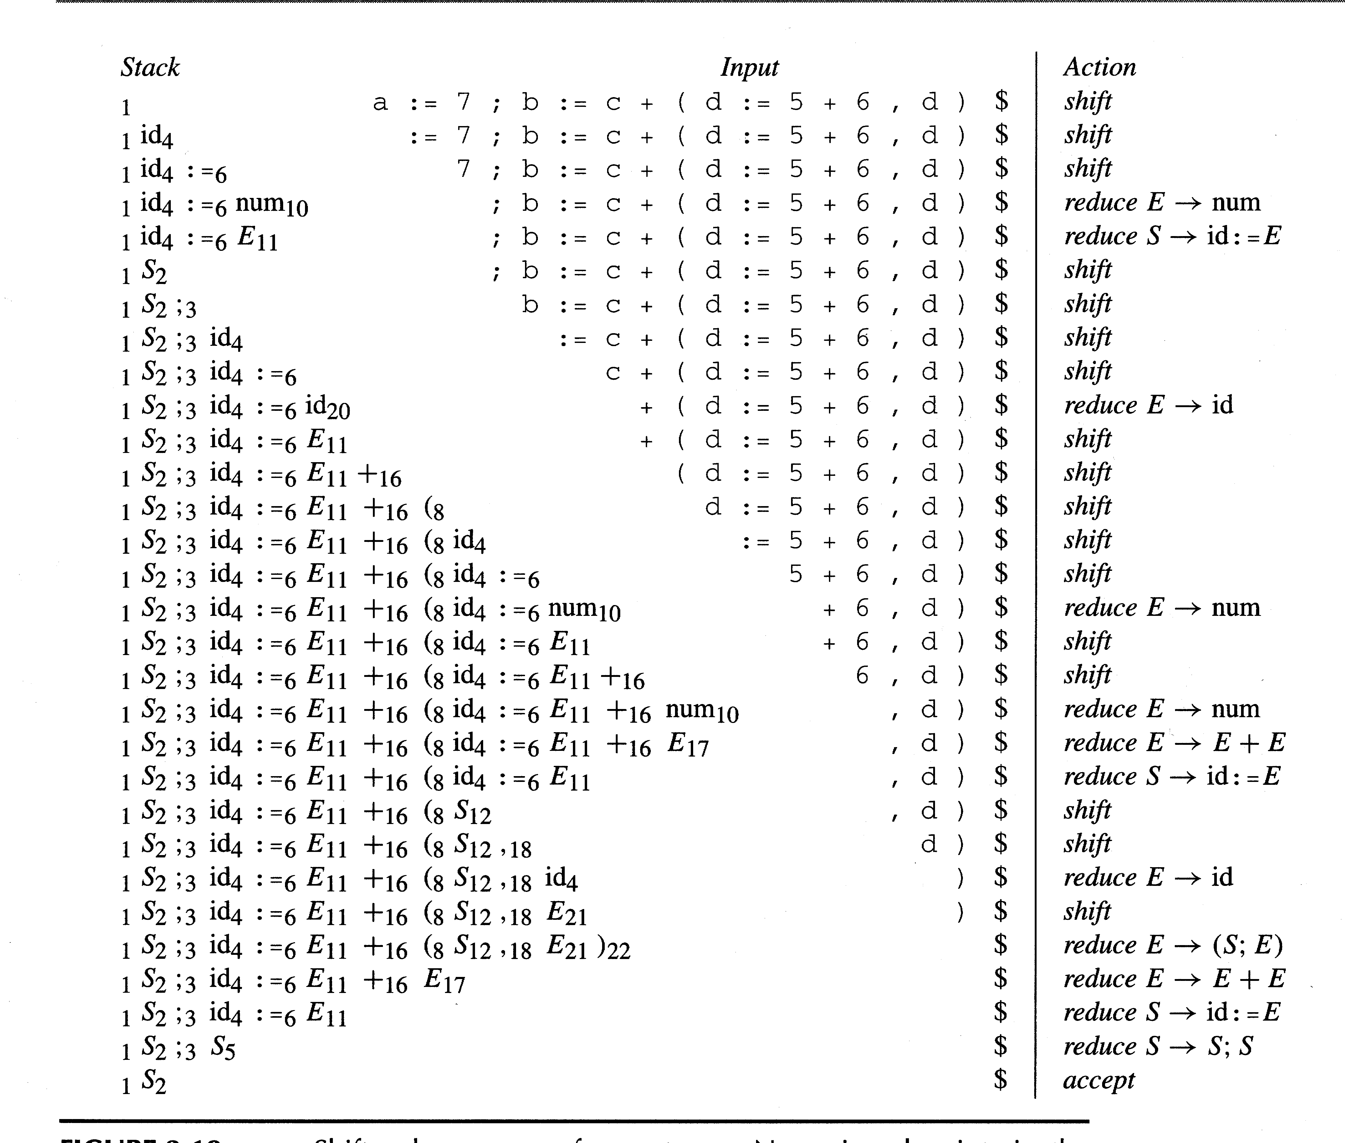

Slide 61
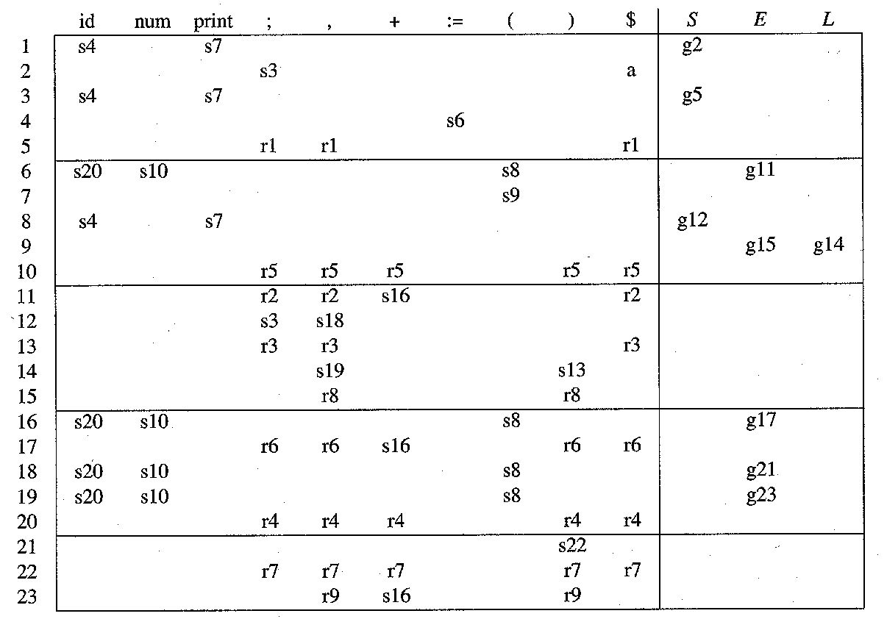
sn Shift into state n; rk Reduce by rule k;
gn Goto state n; a Accept;
Error;

Slide 62
Example:
id := E

